Slide 1

Photonics-Empowered Computing
— From Efficient to Functional Data Movement
Yuyang Wang
Postdoctoral Research Scientist, Columbia Nano Initiative
Columbia University in the City of New York, New York, NY 10027
🖂 yw3831@columbia.edu
January 29, 2025
Notes:
• Thank you for your kind introduction.
• I am happy to give an overview of my research work using integrated silicon photonics to address the communication bottleneck in
computing systems.
• By communication bottleneck I mean that today’s link technologies are consuming too much energy to provide not even enough
bandwidth among computing nodes. This high use of energy and low bandwidth are causing a slowing down of large-scale computational
tasks. This slowing down is the bottleneck that limits the performance of applications like AI and machine learning.
• This bottleneck also prevents the system from being able to scale and support a wide spectrum of real-world applications like climate
modeling, drug discovery, banking, digital twins, and defense applications.
• So my work directly addresses this bandwidth and energy problem.

Slide 2
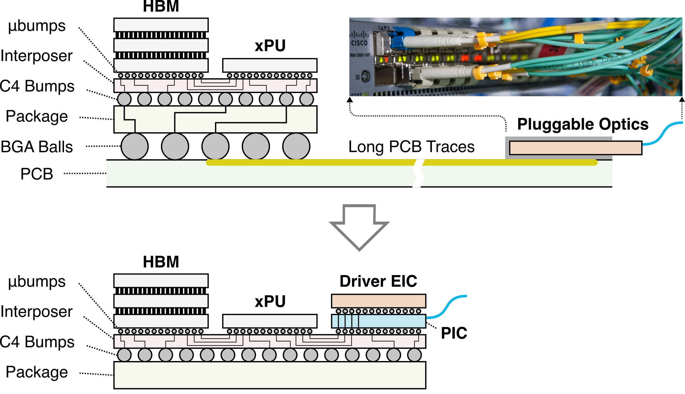
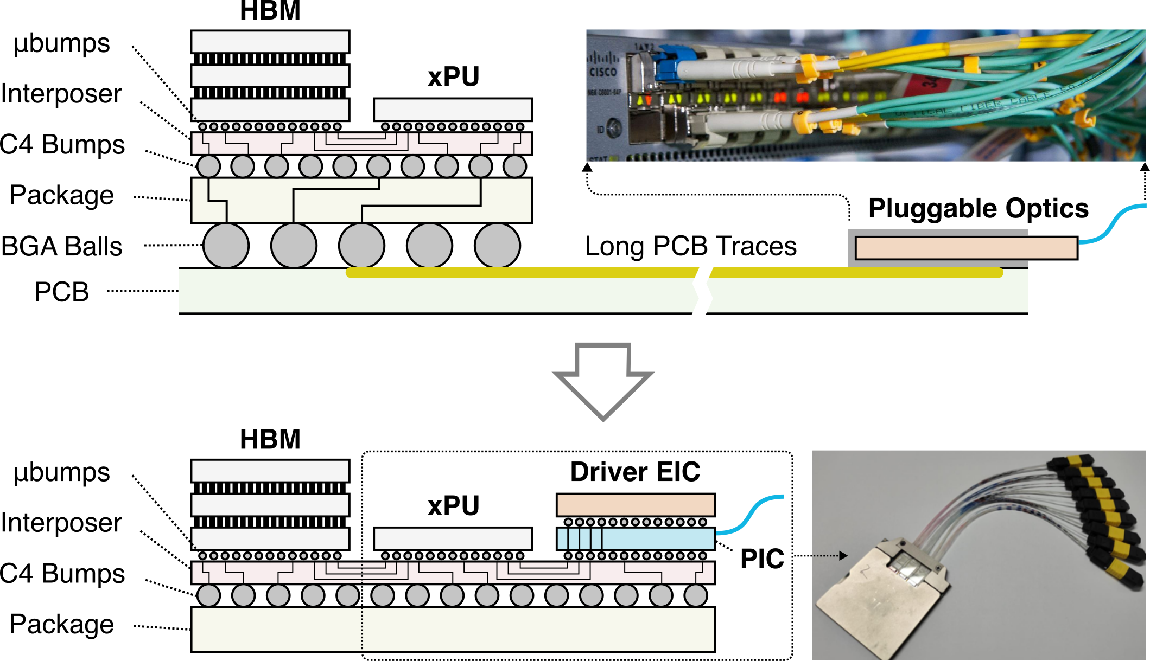
Bringing Photonics into Computing Sockets
Today’s optical connectivity:
My research:
Notes:
Let me tell you about one area of my work. Here, I have focused on bringing photonic technologies into the computing socket to
replace today’s electrical data input/output. This approach is significant because electrical wires start to consume too much energy
when data needs to be sent far away. And by converting data into the optical domain within the socket, it can travel longer distances
with higher bandwidth and lower energy.
• To achieve this, I designed a photonic integrated circuit, that goes into a package like this.

Slide 3
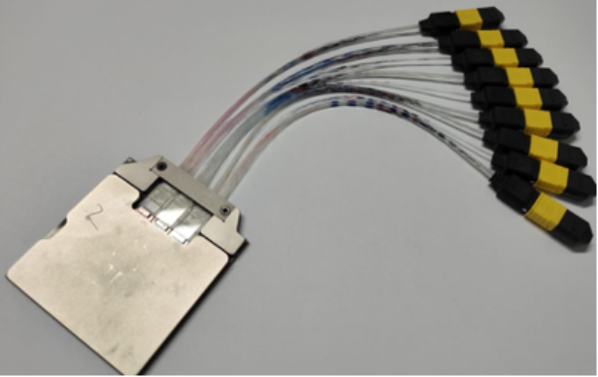
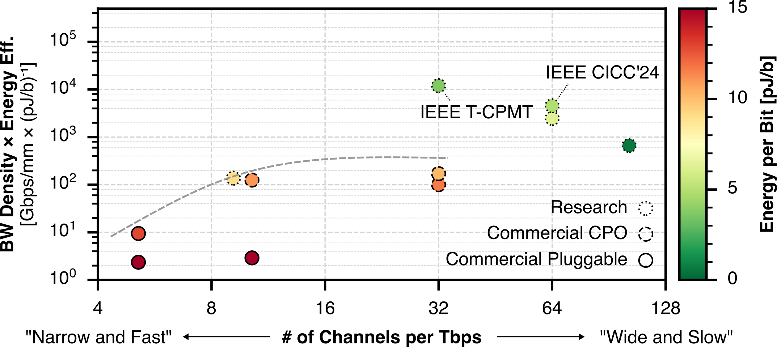
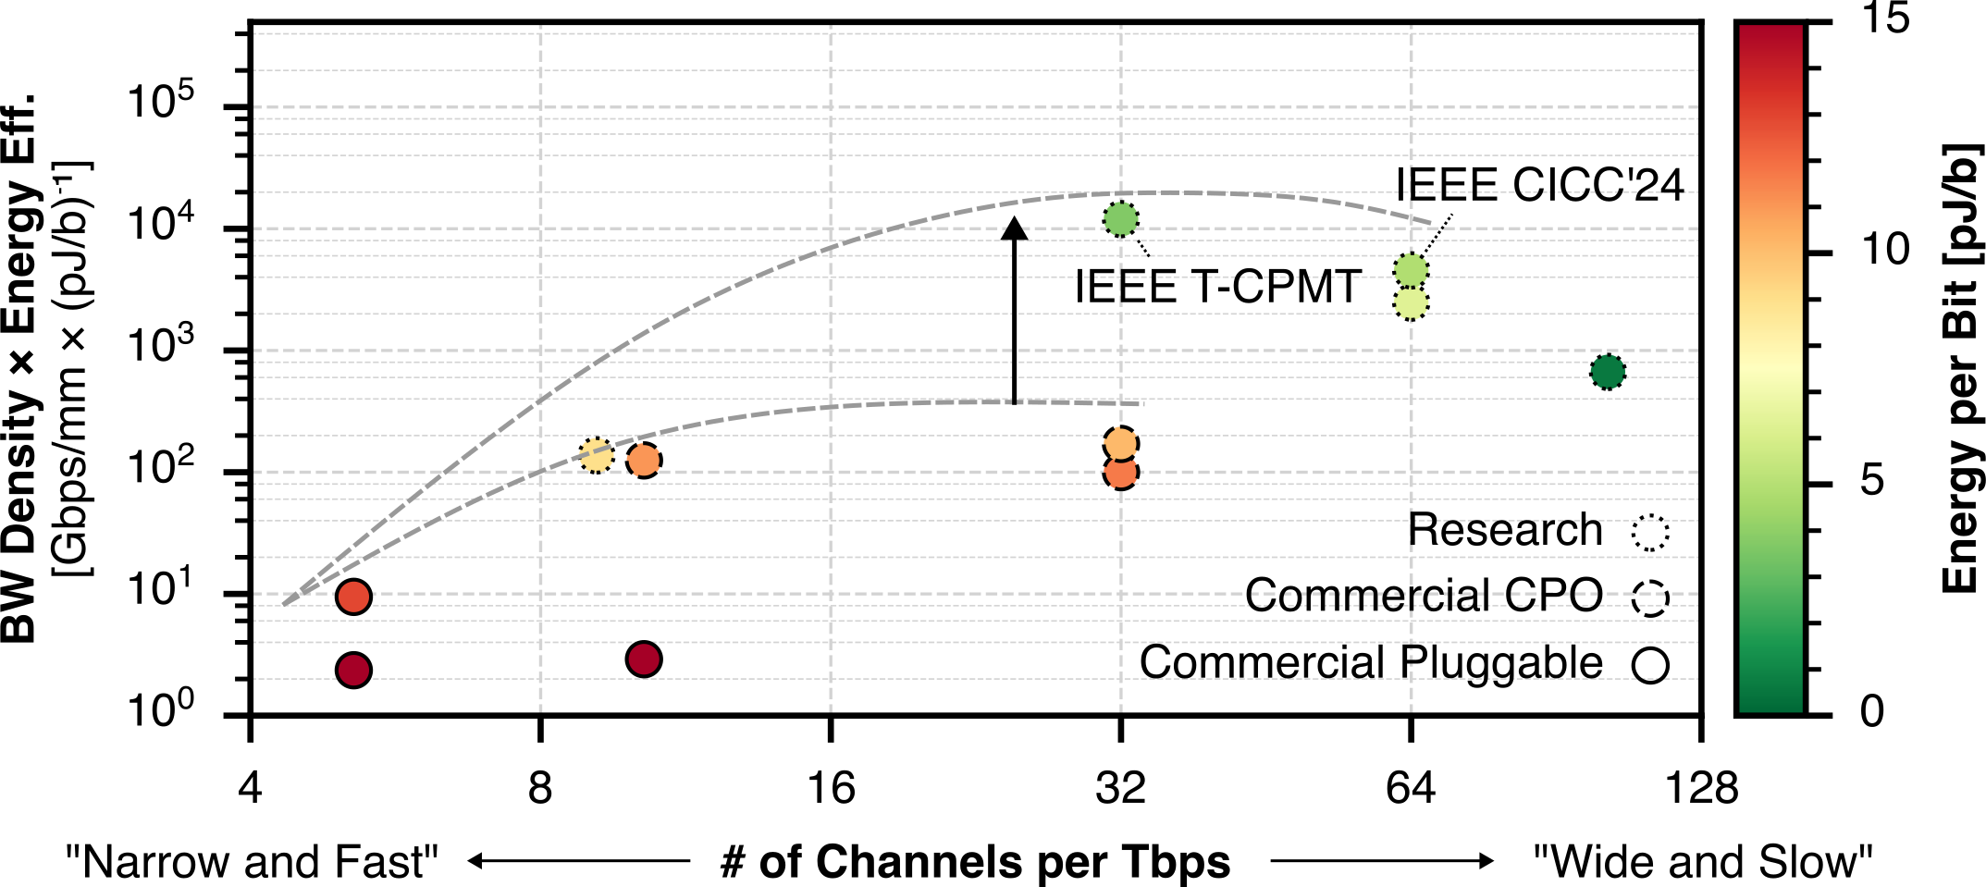
High-Bandwidth Density Energy-Efficient Data I/O
100x
Prior work
96 Tb/s bidirectional
4 Tb/s/mm shoreline
< 1 pJ/b energy
Notes:
This package delivers a 96 Tbps bidirectional
bandwidth with a 4 Tbps/mm bandwidth density, and consumes less than 1 pJ/b. So if we multiply bandwidth density with energy
efficiency, we get an impressive metric. This metric is two orders of magnitude better than the state-of-the-art, which means that we
can greatly improve both the bandwidth density and the energy efficient at the same time.

Slide 4
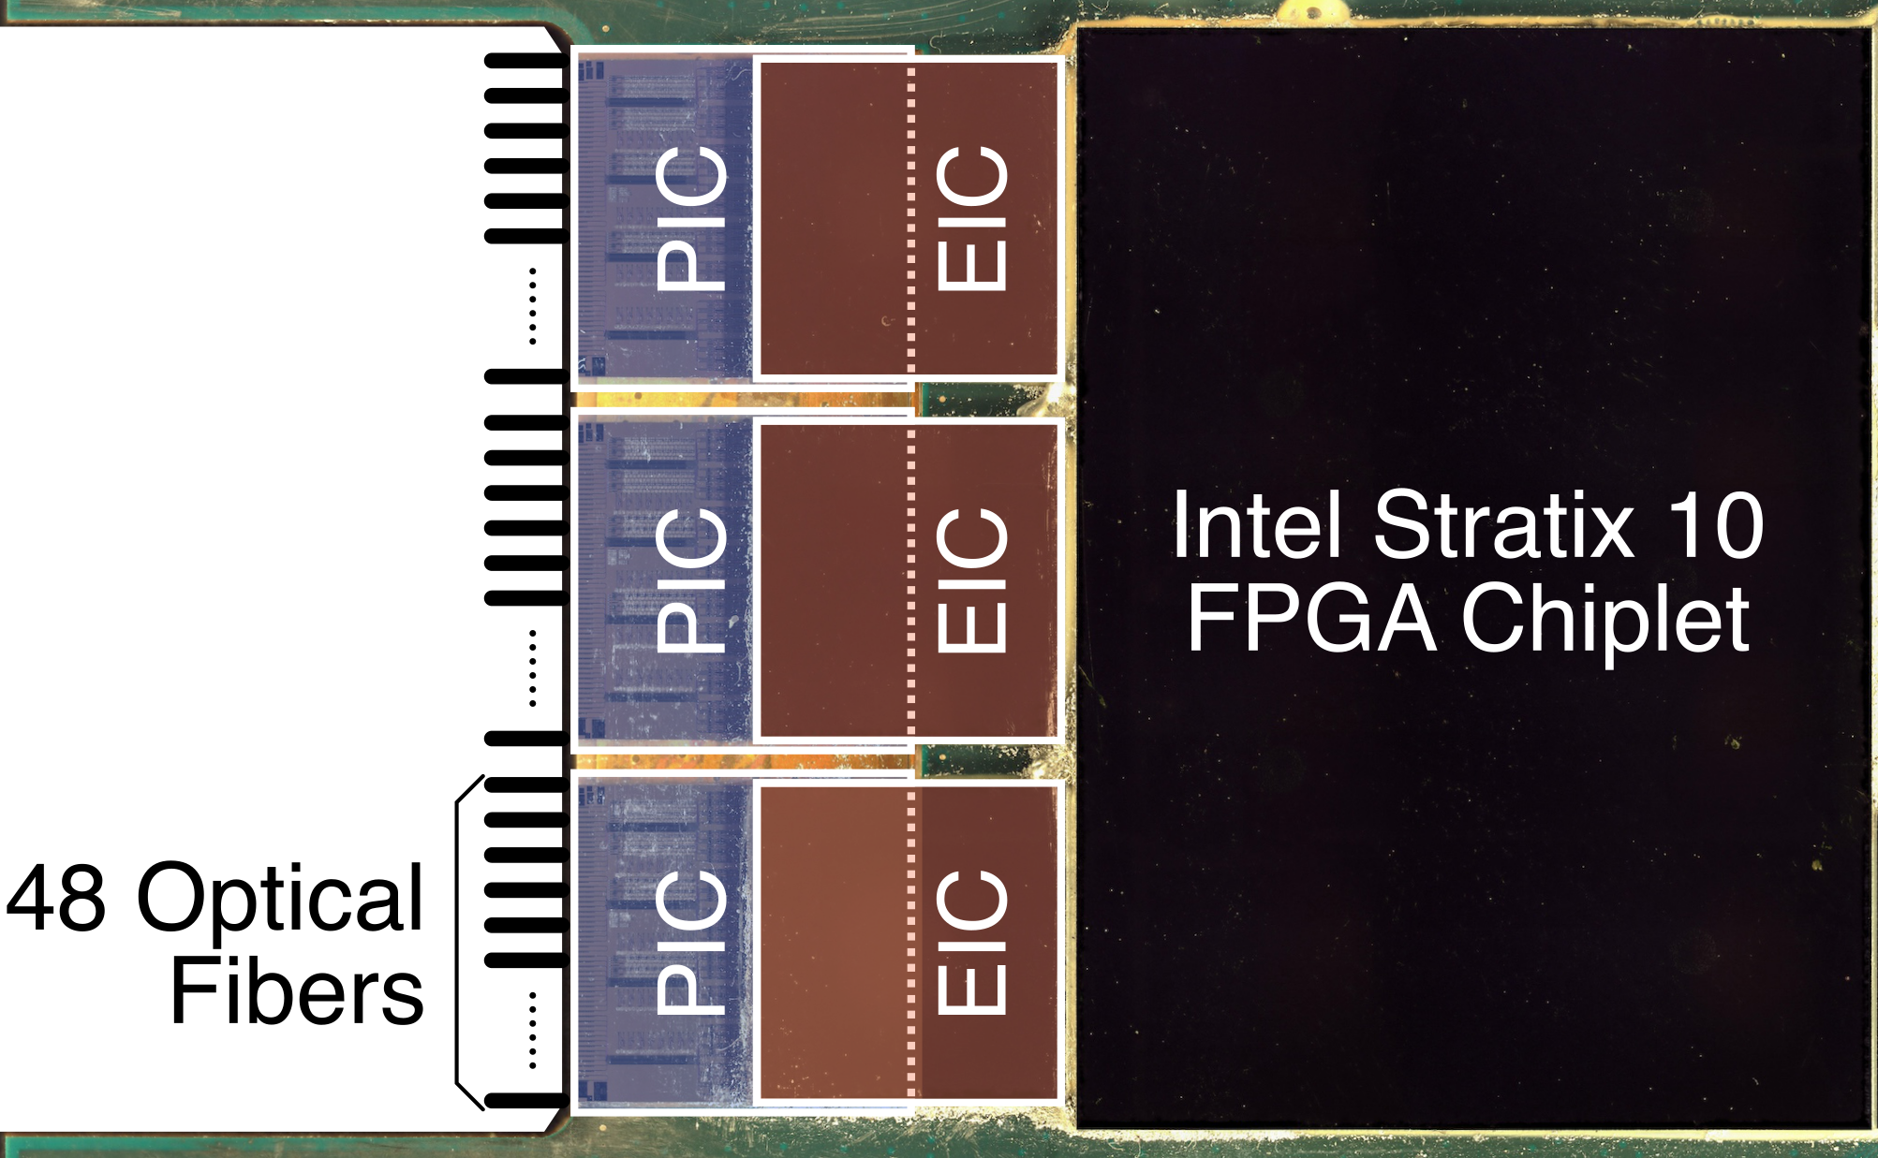
Hybrid 2.5D/3D Integration
PIC: My work
EIC: Cornell
Package: Intel
Notes:
Under the hood, I designed the three photonic chips here, each bonded to an electronic driver chip designed by Cornell University,
and co-packaged with an Intel FPGA chip sitting right next to the photonic data input/output. This tight integration between the
computing chip and the photonic interface is the key to minimizing the extra wiring between the two, which has been a big source of
energy consumption in today’s systems.

Slide 5
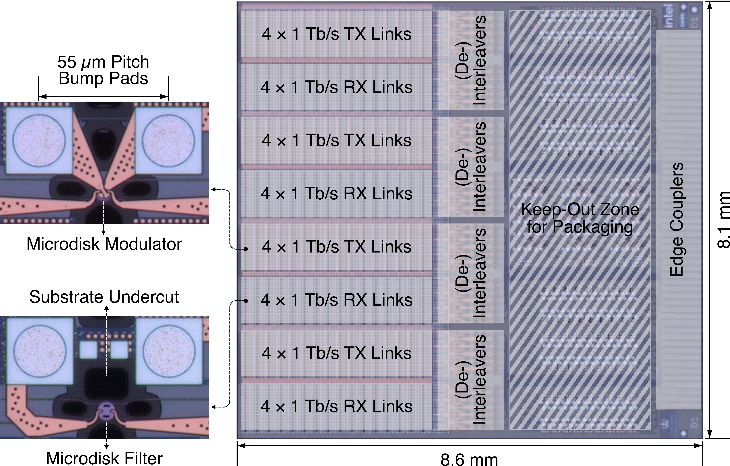
Photonic Chip Design for Packaging
Notes:
Each photonic chip that I am showing here integrates over 2,000 photonic devices, like these microresonator modulators and filters,
into this small 8 mm by 8 mm footprint. This small form factor is what enables the high bandwidth density, and is only possible with the
use of 3D integration of electronics and photonics. As you can see here, this chip was really designed with integration and packaging in
mind.

Slide 6
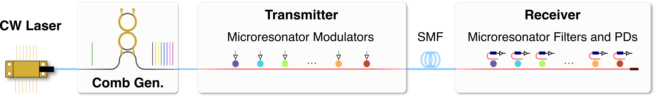
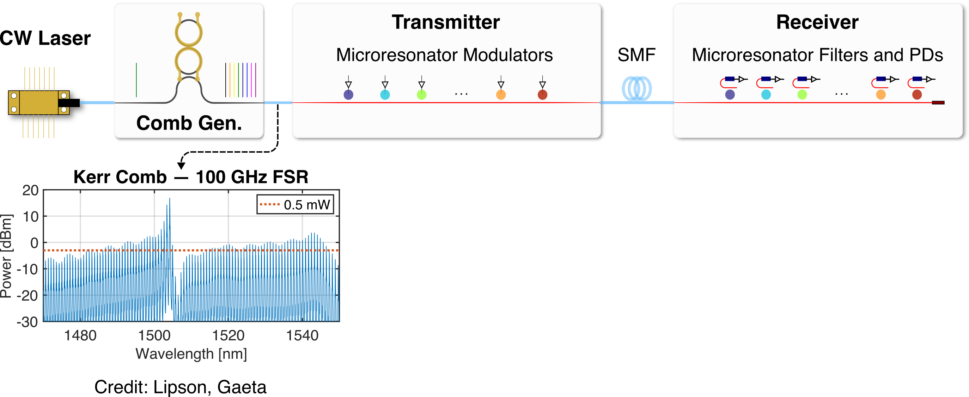
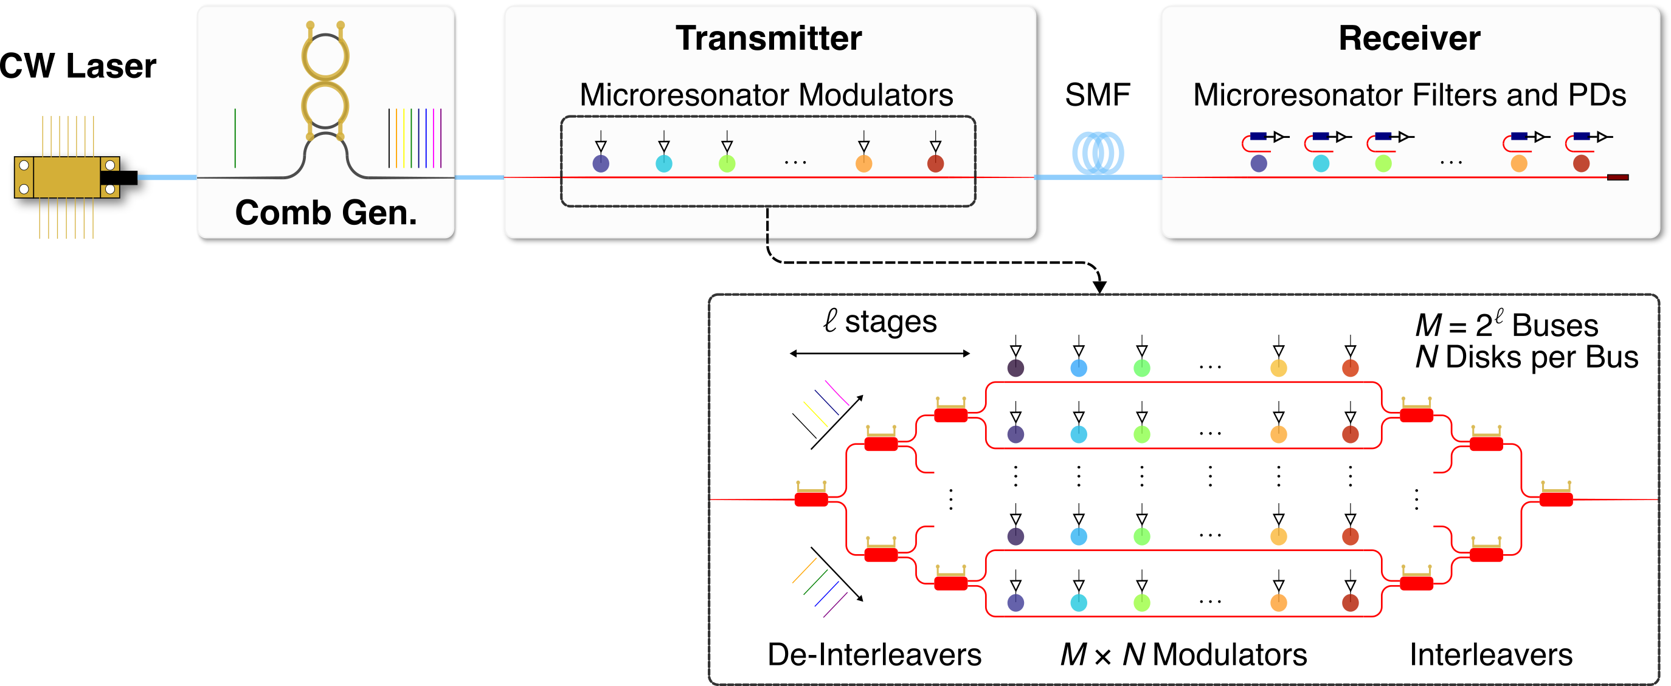
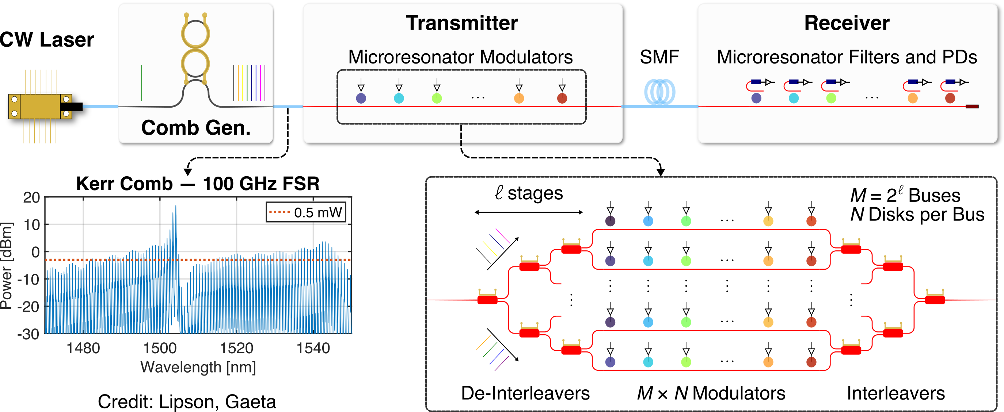
Scalable Link Architecture: Massive Wavelength Parallelism
# of wavelengths per link: from today’s less than 16 to greater than 64
High aggregate bandwidth with moderate data rate per channel
Notes:
To maximize the bandwidth that this photonic chip delivers, I developed a link architecture that greatly increases the number of parallel
wavelength channels per link, from today’s less than 16 to greater than 64. What it really enables is to achieve a high aggregate data rate
while requiring only a moderate data rate per channel. This is what makes the low energy consumption.
• The technology is called comb-driven dense wavelength-division multiplexing. As I am showing here, the link is driven by an optical
frequency comb source based on the non-linear Kerr effect in Silicon Nitride. It can generate tens to hundreds of wavelength channels
from a single laser. Such a high channel count is not feasible if using one individual laser for each channel. All these wavelengths can
carry different streams of data and propagate in the same waveguide or fiber.
• To encode data onto each of these wavelengths, I use a series of microresonator modulators on the transmitter side. Each modulator
only interacts with one wavelength, without affecting the others. The receiver side is similar, but with microresonator filters to separate
the wavelengths onto individual photodetectors.
• Now if I zoom in and show some details of this architecture, this is how I was able to scale up the channel count beyond 64. It is by using
these special interleaving structures that split the wavelengths on to multiple buses, and then recombine them after they’re modulated.
So, this architecture relaxes the communication bottleneck by enabling scalable bandwidth at low energy consumption.

Slide 7
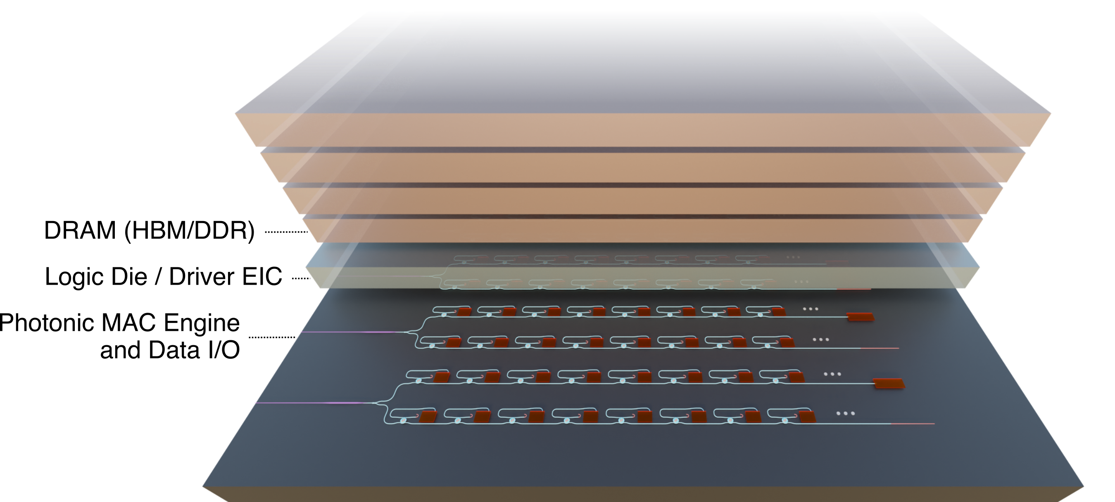
Computing within Data Movement
Notes:
Now, let me talk about a second area of my work. Here, I have focused on enabling computing functionalities within data movement.
This approach reduces the amount of data that needs to be shuttled back and forth between the computing and memory units. This
shuttling of data has become a major energy and performance bottleneck in applications that require frequent memory access.
• What I am showing here is a concept of a photonic architecture that I proposed to accelerate multiply-accumulate, or MAC operations.
MAC operations are fundamental to matrix multiplcation, and it is prevailing in AI and machine learning workloads. Here, by putting
this photonic architecture beneath the memory cell, it can perform MAC operations near memory, as opposed to sending data to the
computing unit for processing and retrieving the results back. And this photonic MAC engine can be integrated into the same chip as
the photonic data I/O, essentially combining data processing with data movement.

Slide 8
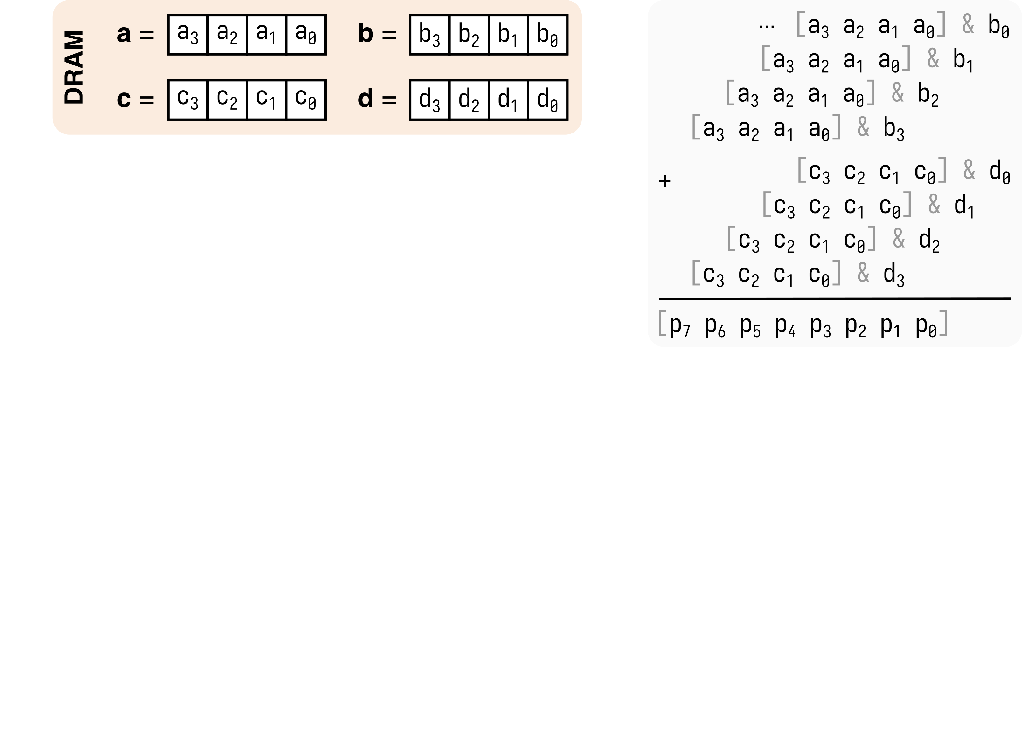
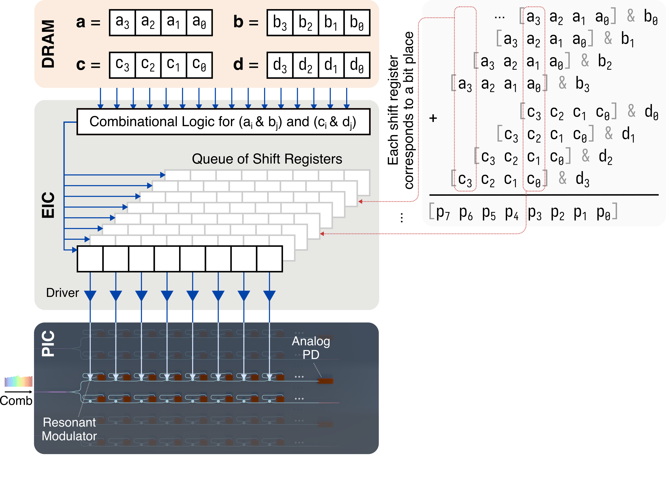
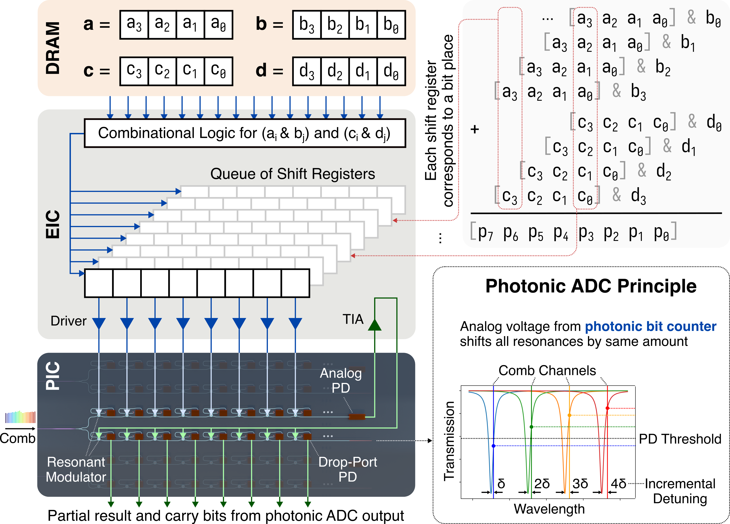
Photonic MAC Operation with Full Digital Precision
Existing Photonic MAC
Computes in analog domain
Extra DAC and ADC steps
Limited precision
My Approach
One wavelength per bit place
Counts # of 1’s instantaneously
Partial results and carry bits from photonic ADC
Retains full digital precision
Notes:
So, here is how this architecture works, and how it addresses the limitations of some existing photonic MAC implementations. Let’s
say we want to do this 4-bit MAC operation. Traditionally, we would send these numbers to a GPU, do the computation there, and then
get the result back. We don’t want to do that. There are also some existing photonic MAC implementations, either based on cascaded
Mach-Zehnder interferometers or microring weight banks. But they typically encode data into an analog optical property, like phase
or intensity. So these approaches A) require extra steps to convert these numbers into analog signals to drive the photonic components,
and B) are limited in bit precision since photonic devices are very sensitive to fabrication and environmental purturabations.
• In my approach, I address these limitations by keeping the multipliers and multiplicands in the digital domain. And then I leverage the
high wavelength parallelism that I have been pushing in my first work, and assign each of these bit places a unique wavelength. Each bit
place drives a microresonator modulator in a digital fashion, either let the light pass or block it. So, with this analog photodetector, we
can instantaneously get the number of ones in this bit place, and this will be converted to the partial result for this bit place and the
carry bits to higher bit places.
• I also proposed to do this conversion from analog to digital in the optical domain, because it is very challenging to design a fast and
energy-efficient electrical ADC with a high bit count. So here, I use the signal from the analog PD to drive a series of microresonator
modulators which are biased incrementally away from their resonance. This way, the same driving voltage will flip only a subset of
these modulators, depending on the voltage level.
• And finally, this approach can retain the full precision of the input data, as long as we have enough parallel wavelength channels. This is
where the comb-driven DWDM architecture can really help. For example, with 64 wavelength channels, we can do a MAC operation
where each of these numbers has 32 bits.

Slide 9
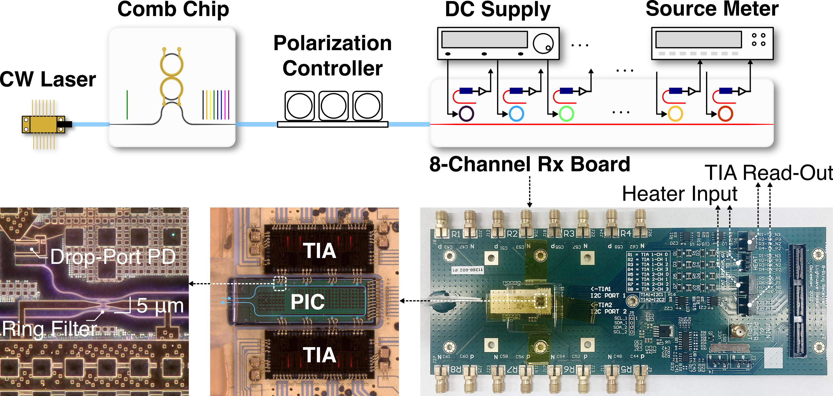
Hardware Validation of Photonic MAC Architecture
Notes:
I have used a test board that we previously fabricated to validate this concept. The photonic chip has 8 microring resonators cascaded
along the same waveguide. Each resonator can be electrically tuned, and the drop-port signal can be read from a transimpedance
amplifier that’s integrated on the same board.

Slide 10
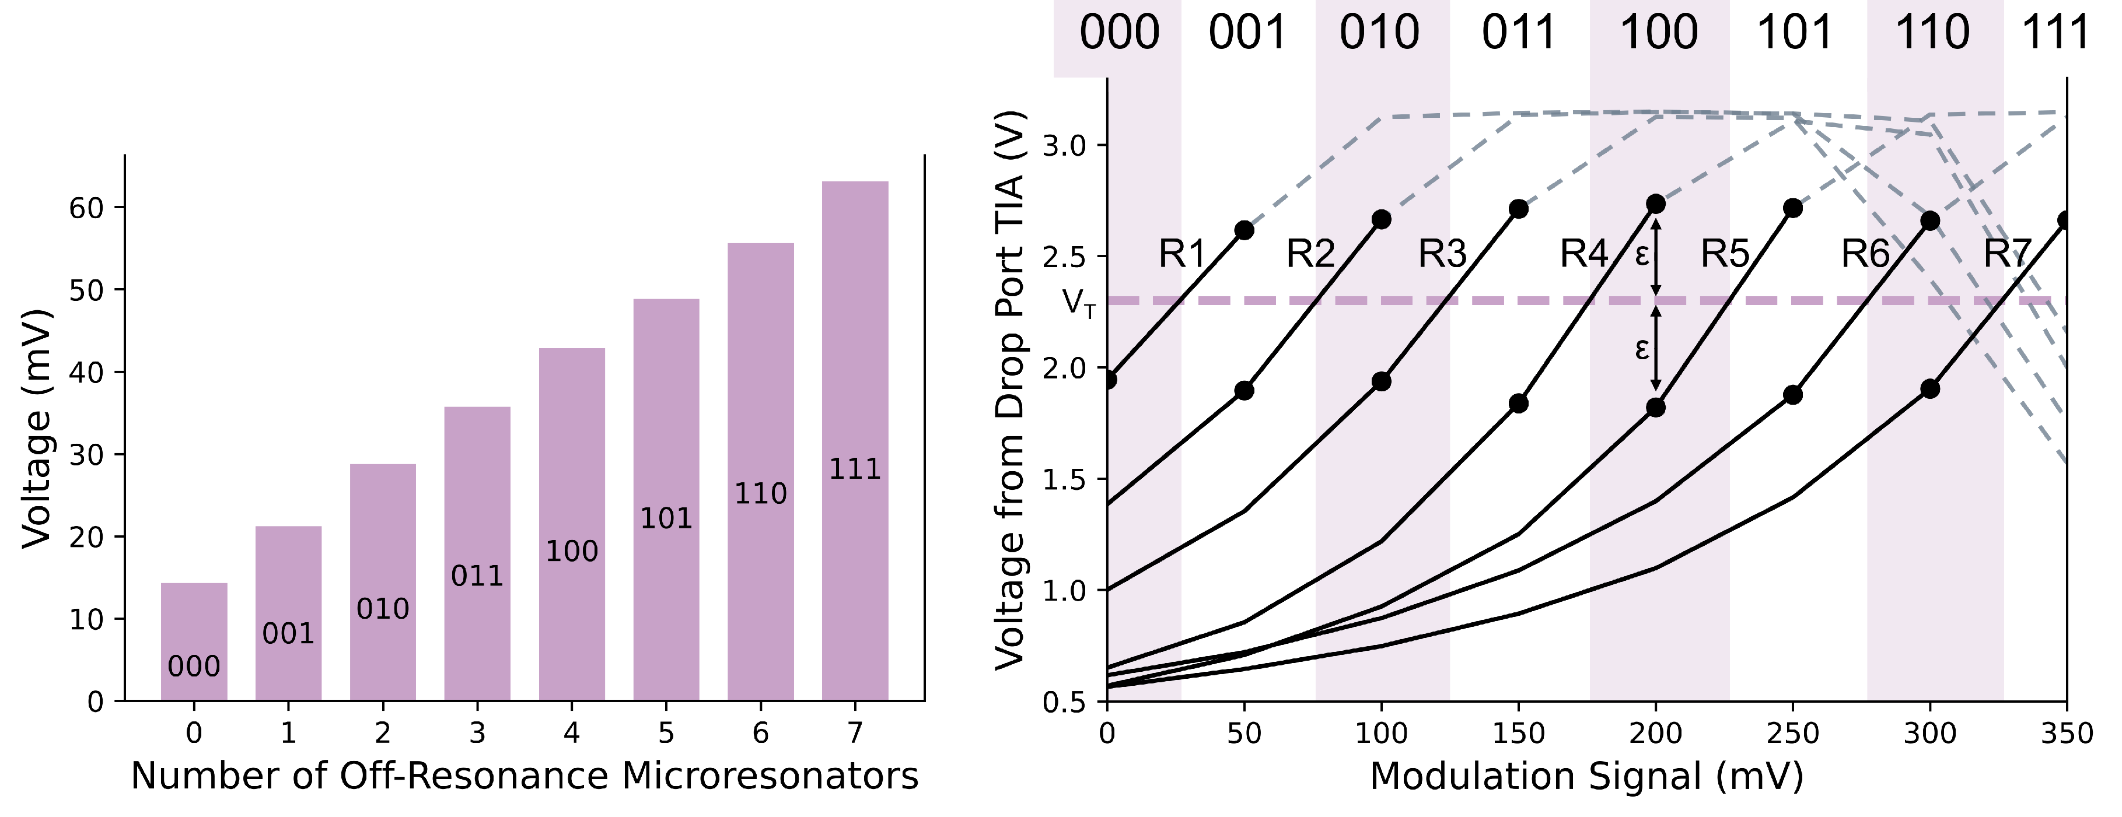
Photonic Bit Counting and ADC
# of 1’s → Voltage
Amplified Voltage → Digital
Notes:
Here, I am showing an example where I played with the number of ones and get the reading from the analog photodetector. The voltage
levels are quite distinct, because the resonators operate in a binary fashion and their extinction ratios are very high. On the right, I am
showing the result of using this voltage, after some amplification, to drive the photonic ADC bus. And we can see that different rings
will cross this flipping threshold at a different voltage level, and this is how we can convert the analog signal back into digital.
• And in our next tape-out run, which will happen in February, I am working on putting down a dedicated chip design that has the two
functionalities combined. And, I am very hopeful that it will make a cool system demonstration of this photonic-enabled computing
architecuture.

Slide 11
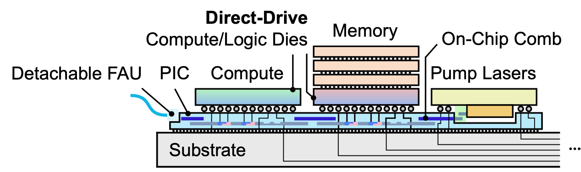
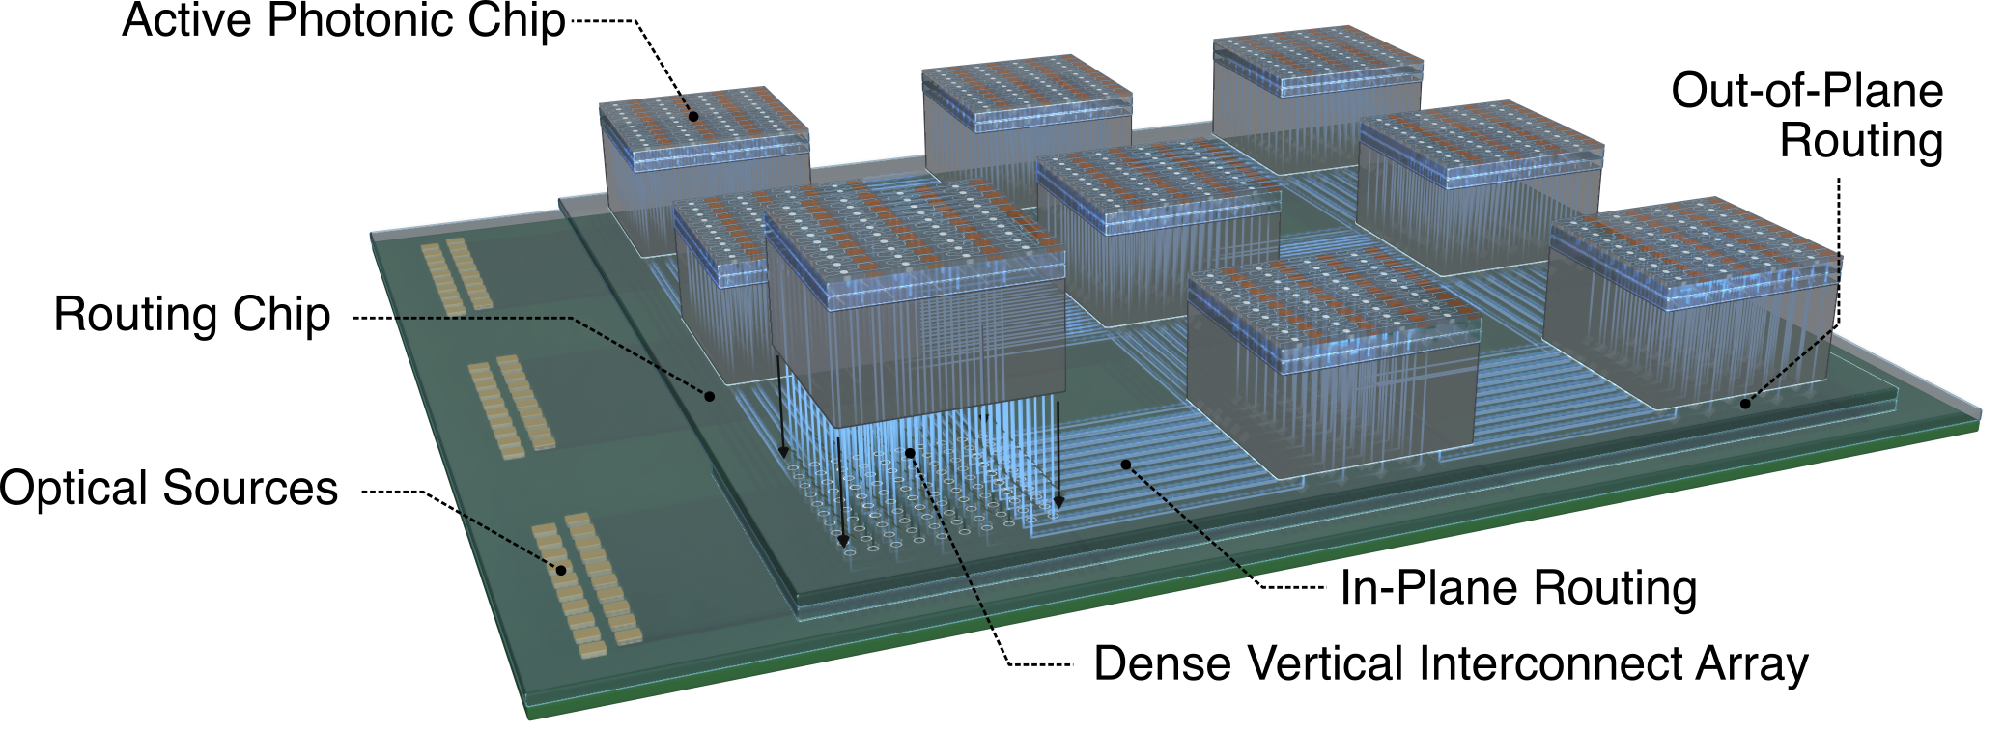
Future Directions
Heterogeneous Integration
Integrated comb source
Direct-drive photonics
3D Photonic Connectivity
Break planar photonics limitations
Wafer- / Panel-scale computing
Network-Application Co-Design
Acceleration and energy saving
Diverse application, e.g., RF
Collaborations
Photonics for RF/Wireless (Xiao, Biswas)
Architectures for AI/HPC (Chen, Aktulga)
Heterogeneous Integration and Packaging (Yazdi [ECE])
Notes:
Now, let me talk about the future.
• One exciting extension of my work is to use heterogeneous integration technologies to build a computing node that has an integrated
comb source, and the photonic components are directly driven by the computing or the memory chip. My preliminary link budget
analysis shows that this approach is promising for at least another ten times greater energy efficiency by eliminating the overhead from
the driver circuitry altogether.
• A little further into the future, I am also interested in exploring the possibility of doing optical routing in the 3rd dimension. This breaks
away from the density limitations of today’s planar optical routing. It also enables a new connectivity paradigm where more chips can
be integrated onto a big photonic substrate, and can be potentially very useful for enabling wafer-scale or panel-scale computing.
• Another exciting direction is to accelerate the computation tasks through network-application co-design. Because, If the computation
can be done in a fraction of the time it takes today, there is going to be a great amount of energy saving from the computing side, in
addition to the energy saving from data movement itself.
• And additionally, I plan to look at how photonic technologies can be applied to more applications, such as having a photnoic backend
for large-scale distributed antenna arrays. By leveraging the bandwidth and data processing capabilities in photnoics, we can potentially
scale up the number of antennas in an array by orders of magnitude.
• To pursue these directions, I think I will highly benefit from collorations with the faculty members at [School Name]. For example, I believe I would highly benefit from collaborating with Prof. Xiao and Prof. Biswas to explore the use of photonic technologies as a potential RF/wireless backend for large-scale distributed antenna arrays; with Prof. Chen and Prof. Aktulga to explore network-application co-design for AI/high-performance computing applications. I am also excited about the opportunity to collaborate some of the ECE faculty who have the expertise in heterogeneous integration and advanced packaging, such as Prof. Yazdi, to build system prototypes.

Slide 12
Thank you!

